Slide 1
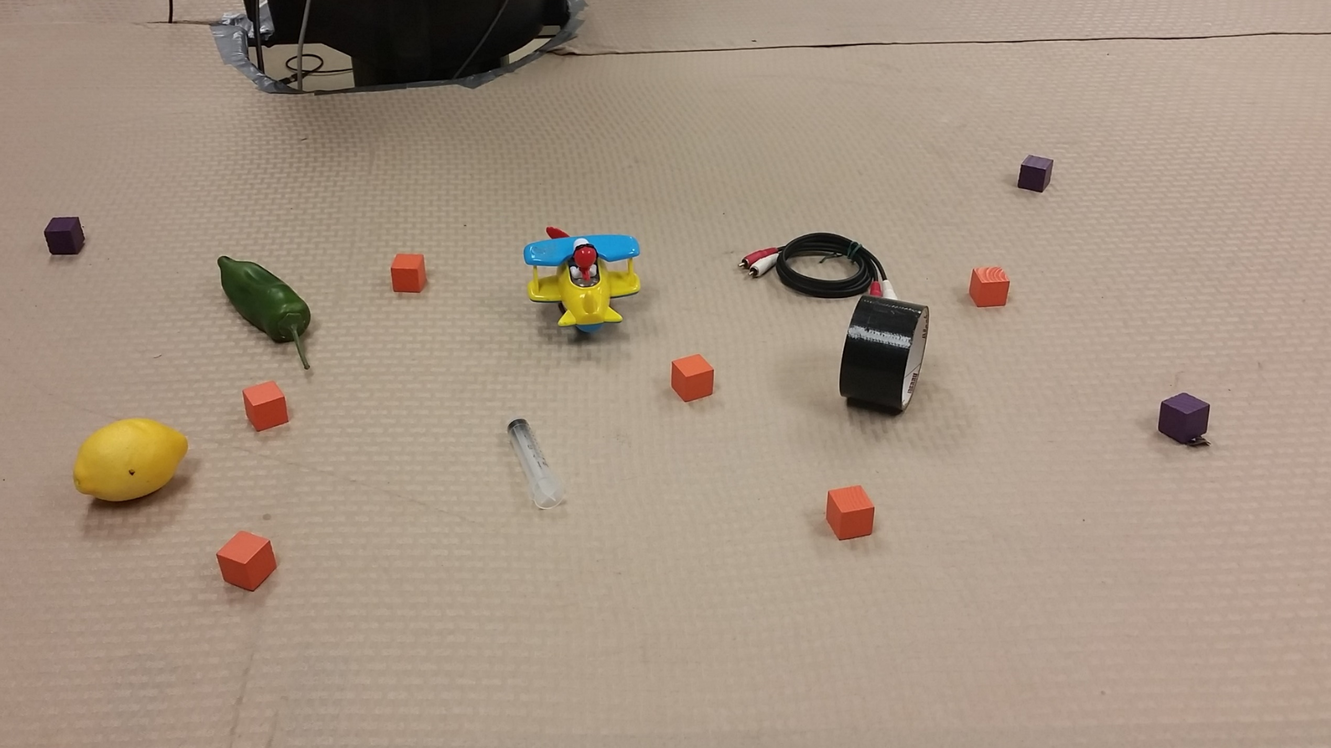
Incrementally Parsing Referring Expressions using Spatial Object Models
Gaurav Manek
Advisor: Prof. Stefanie Tellex
Reader: Prof. Eugene Charniak
Notes:
Incremental evaluation of example #368 from the test set.

Slide 2
3
6
4
1
5
2
“Orange cube between the toy and the tape roll”
Notes:
Incremental evaluation of example #368 from the test set.

Slide 3
The Problem
Referring expressions
with prepositions.
Incremental updates
update the distribution as each word is added.
The
…orange cube
…between the red
…and the yellow.

Slide 4
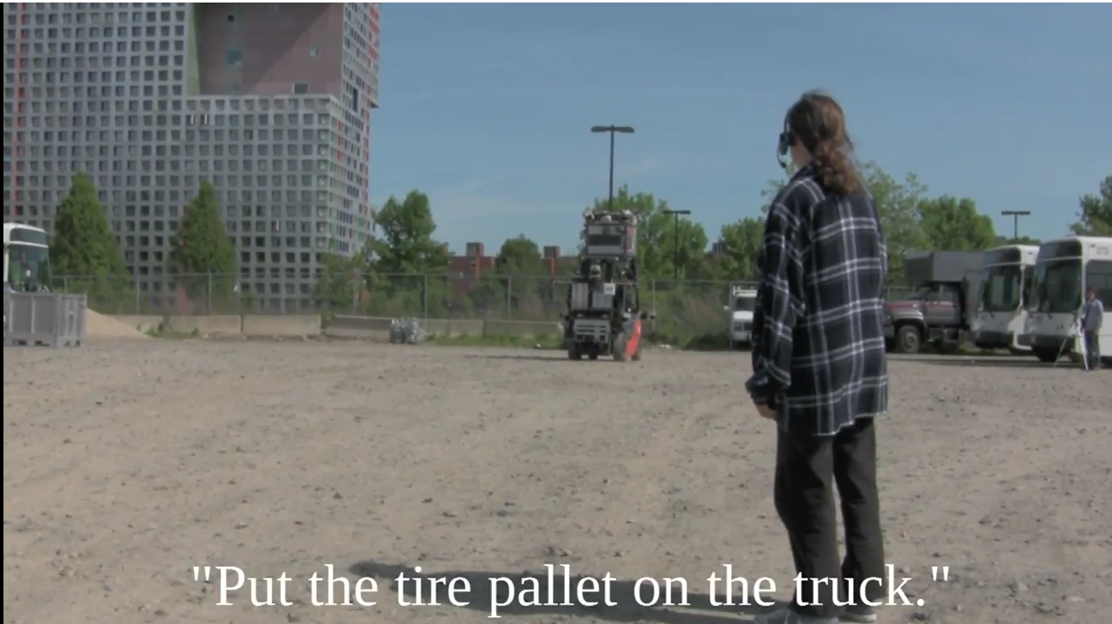
Existing Work
A Robotic Forklift Following Commands (Tellex, 2013)
Notes:
This particular command took just under ten seconds to parse. G3 system can take up to 30 seconds between

Slide 5
Batch Mode
¯_¯
¯_¯
¯_¯
◠‿◠
“Orange cube between the toy and the tape roll”
| | | | | | | | | | | | | | | | | | | | | | | | | | | | | | | | | | | | | | | | | | | | | | | | | | | | | | | | | | | | | | | | | | | | | | | | | | | | | | | | | | | | | | | | | | | | | | | | | | | | | | |
¯_¯
¯‿¯
◠‿◠
^‿^
Incremental Mode
Notes:
As you give it each word in a sentence, it quickly updates its output to reflect the current state.
Social feedback: As we progress through the sentence, the robot face changes to show understanding.

Slide 6
3
6
4
1
5
2
“Orange cube between the toy and the tape roll”
Notes:
Incremental evaluation of example #368 from the test set.

Slide 7
3
6
4
1
5
2
“—

Slide 8
16%
16%
3
6
16%
16%
4
1
16%
16%
5
2
“Orange—

Slide 9
16%
16%
3
6
16%
16%
4
1
16%
16%
5
2
“Orange cube—

Slide 10
16%
15%
3
6
20%
17%
4
1
15%
14%
5
2
“Orange cube between—

Slide 11
16%
15%
3
6
20%
17%
4
1
15%
14%
5
2
“Orange cube between the—

Slide 12
20%
14%
3
6
23%
16%
4
1
13%
11%
5
2
“Orange cube between the toy—

Slide 13
20%
14%
3
6
23%
16%
4
1
13%
11%
5
2
“Orange cube between the toy and—

Slide 14
20%
14%
3
6
23%
16%
4
1
13%
11%
5
2
“Orange cube between the toy and the—

Slide 15
24%
14%
3
6
28%
9%
4
1
17%
5%
5
2
“Orange cube between the toy and the tape—

Slide 16
24%
14%
3
6
29%
8%
4
1
18%
4%
5
2
“Orange cube between the toy and the tape roll”

Slide 17
Technical Approach

Slide 18
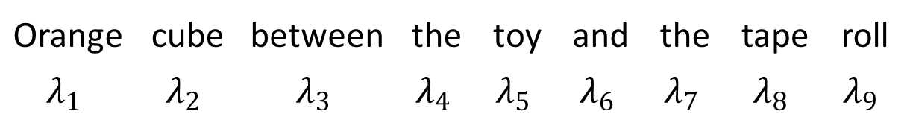
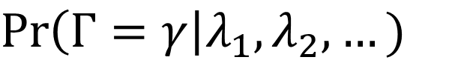
Distribution (over all objects)
that the input refers to.
Input words
$$\operatorname{Pr}\left(Γ=γ\right|λ_{1},λ_{2},…)$$
Target object
Orange | cube | between | the | toy | and | the | tape | roll
$$λ_{1}$$ | $$λ_{2}$$ | $$λ_{3}$$ | $$λ_{4}$$ | $$λ_{5}$$ | $$λ_{6}$$ | $$λ_{7}$$ | $$λ_{8}$$ | $$λ_{9}$$

Slide 19
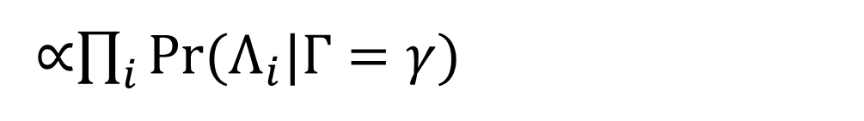
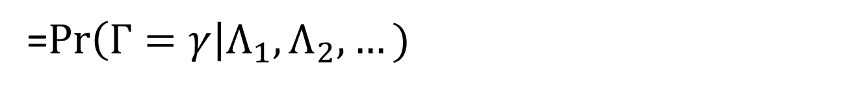
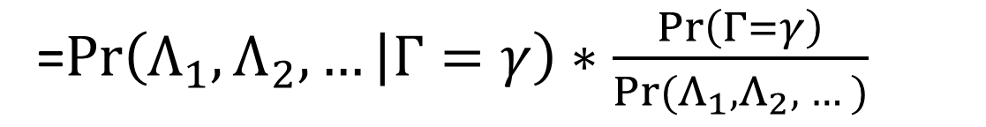
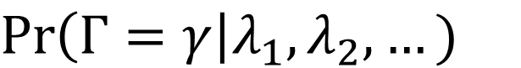
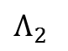
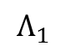
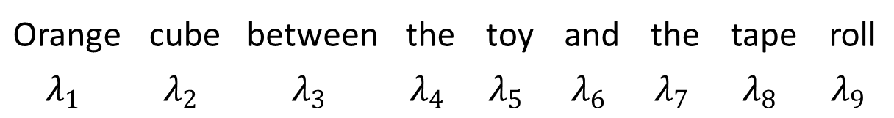
$$\operatorname{Pr}\left(Γ=γ\right|λ_{1},λ_{2},…)$$
=$\operatorname{Pr}\left(Γ=γ\right|Λ_{1},Λ_{2},…)$
=$\operatorname{Pr}\left(Λ_{1},Λ_{2},… | Γ=γ\right)∗\frac{\operatorname{Pr}\left(Γ=γ\right)}{Pr⁡(Λ_{1},Λ_{2}, …)}$
∝$\prod_{i}^{ }{Pr(Λ_{i}|Γ=γ)}{ }$
Orange | cube | between | the | toy | and | the | tape | roll
$$λ_{1}$$ | $$λ_{2}$$ | $$λ_{3}$$ | $$λ_{4}$$ | $$λ_{5}$$ | $$λ_{6}$$ | $$λ_{7}$$ | $$λ_{8}$$ | $$λ_{9}$$
$$Λ_{1}$$
$$Λ_{2}$$

Slide 20
Orange | cube | between | the | toy | and | the | tape | roll
$$Λ_{1}$$
$$Λ_{2}$$

Slide 21
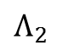
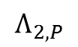
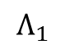
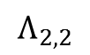
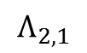
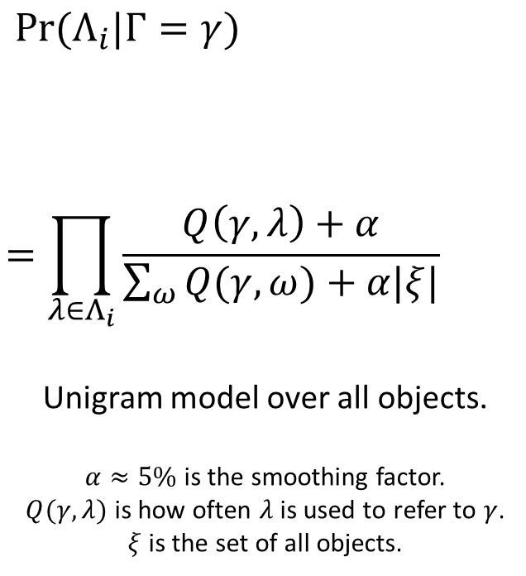
Orange | cube | between | the | toy | and | the | tape | roll
$$Λ_{1}$$
$$Λ_{2}$$
$$Λ_{2,P}$$
$$Λ_{2,1}$$
$$Λ_{2,2}$$
$$\operatorname{Pr}{(Λ_{i}|Γ=γ) }$$
$$=\prod_{λ∈Λ_{i}}{\frac{Q\left(γ,λ\right)+α}{\sum_{ω}{Q(γ,ω)}+α|ξ|}}$$
Unigram model over all objects.
$α≈5\%$ is the smoothing factor.
$Q(γ,λ)$ is how often $λ$ is used to refer to $γ$.
$ξ$ is the set of all objects.

Slide 22
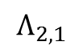
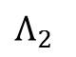
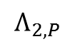
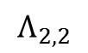
Orange | cube | between | the | toy | and | the | tape | roll
$$Λ_{2}$$
$$Λ_{2,P}$$
$$Λ_{2,1}$$
$$Λ_{2,2}$$

Slide 23
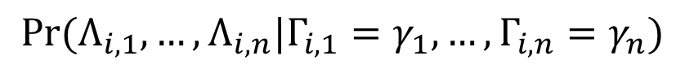
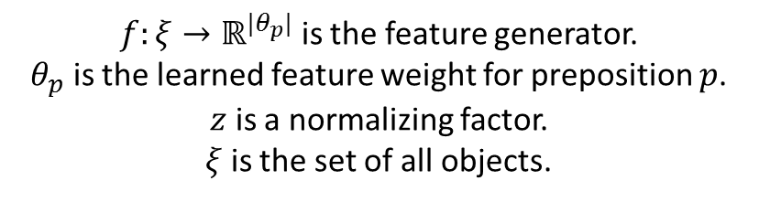
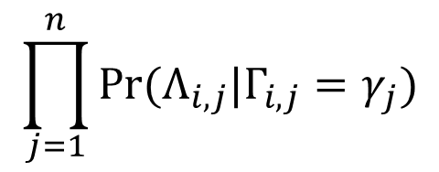
Orange | cube | between | the | toy | and | the | tape | roll
$$Λ_{2}$$
$$Λ_{2,P}$$
$$Λ_{2,1}$$
$$Λ_{2,2}$$
$$\operatorname{Pr}{(Λ_{i}|Γ=γ)={\operatorname{Pr}{(Λ_{i,P},Λ_{i,1},…,Λ_{i,n}| Γ =γ)}} }$$
$$={\sum_{γ_{1}∈ξ}{⋯\sum_{γ_{n}∈ξ}{\operatorname{Pr}{(Λ_{i,P}, Γ_{i,1}=γ_{1}, …,Γ_{i,n}=γ_{n}| Γ =γ)}⋅}}}$$
$$\operatorname{Pr}{(Λ_{i,1},…,Λ_{i,n}|Γ_{i,1}=γ_{1}, …,Γ_{i,n}=γ_{n})}$$
$$\prod_{j=1}^{n}{\operatorname{Pr}{(Λ_{i,j}|Γ_{i,j}=γ_{j})}}$$
$$∝{\sum_{γ_{1}∈ξ}{⋯\sum_{γ_{n}∈ξ}{S\left(\frac{f\left(γ, γ_{1},{…,γ}_{n} \right)⋅θ_{p}}{z}\right)⋅}}}$$
Preposition Model
Groundings
$f:ξ→ℝ^{|θ_{p}|}$ is the feature generator.
$θ_{p}$ is the learned feature weight for preposition $p$.
$z$ is a normalizing factor.
$ξ$ is the set of all objects.

Slide 24
“…near the orange square”
$$S\left(\frac{f\left( , γ_{1}\right)⋅θ_{p}}{z}\right)⋅\operatorname{Pr}{("orange square"|Γ_{1,1}=γ_{1})}$$

Slide 25
“…near the orange square”
$$S\left(\frac{f\left( , γ_{1}\right)⋅θ_{p}}{z}\right)⋅\operatorname{Pr}{("orange square"|Γ_{1,1}=γ_{1})}$$

Slide 26
“…near the orange square”
$$S\left(\frac{f\left( , γ_{1}\right)⋅θ_{p}}{z}\right)⋅\operatorname{Pr}{("orange square"|Γ_{1,1}=γ_{1})}$$

Slide 27
Marginalize over all groundings
$$S\left(\frac{f\left( , γ_{1}\right)⋅θ_{p}}{z}\right)⋅\operatorname{Pr}{("orange square"|Γ_{1,1}=γ_{1})}$$
+
$$S\left(\frac{f\left( , γ_{1}\right)⋅θ_{p}}{z}\right)⋅\operatorname{Pr}{("orange square"|Γ_{1,1}=γ_{1})}$$
+
$$S\left(\frac{f\left( , γ_{1}\right)⋅θ_{p}}{z}\right)⋅\operatorname{Pr}{("orange square"|Γ_{1,1}=γ_{1})}$$

Slide 28
Orange | cube | between | the | toy | and | the | tape | roll
$$Λ_{2}$$
$$Λ_{2,P}$$
$$Λ_{2,1}$$
$$Λ_{2,2}$$
$$\operatorname{Pr}{(Λ_{i}|Γ=γ)={\operatorname{Pr}{(Λ_{i,P},Λ_{i,1},…,Λ_{i,n}| Γ =γ)}} }$$
$$={\sum_{γ_{1}∈ξ}{⋯\sum_{γ_{n}∈ξ}{\operatorname{Pr}{(Λ_{i,P}, Γ_{i,1}=γ_{1}, …,Γ_{i,n}=γ_{n}| Γ =γ)}⋅}}}$$
$$\operatorname{Pr}{(Λ_{i,1},…,Λ_{i,n}|Γ_{i,1}=γ_{1}, …,Γ_{i,n}=γ_{n})}$$
$$\prod_{j=1}^{n}{\operatorname{Pr}{(Λ_{i,j}|Γ_{i,j}=γ_{j})}}$$
$$∝{\sum_{γ_{1}∈ξ}{⋯\sum_{γ_{n}∈ξ}{S\left(\frac{f\left(γ, γ_{1},{…,γ}_{n} \right)⋅θ_{p}}{z}\right)⋅}}}$$
Preposition Model
Groundings
$f:ξ→ℝ^{|θ_{p}|}$ is the feature generator.
$θ_{p}$ is the learned feature weight for preposition $p$.
$z$ is a normalizing factor.
$ξ$ is the set of all objects.

Slide 29
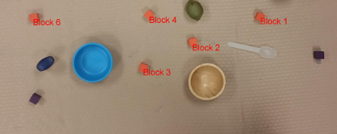
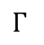
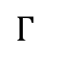
Implementation
Back to Cache
Output
$$Γ$$
the toy
Unigram Evaluation
+ Prepositional Phrase Evaluation
the tape
Orange cube
between
Orange cube
Tree Reconstruction
$$Γ$$
the toy
between
the tape
CRF Tagging
Orange | cube | between | the | toy | and | the | tape
SNP | SNP | PRP | SNP | SNP | PRP | SNP | SNP
Cache
Scene
Sentence
Next Word

Slide 30
CRF Tagging
Average of 0.223 tags changed for each added word.
Orange | cube | between | the | toy | and | the | tape | roll
SNP | SNP | PRP | SNP | SNP | PRP | SNP | SNP | SNP
Look-behind
Look-ahead

Slide 31
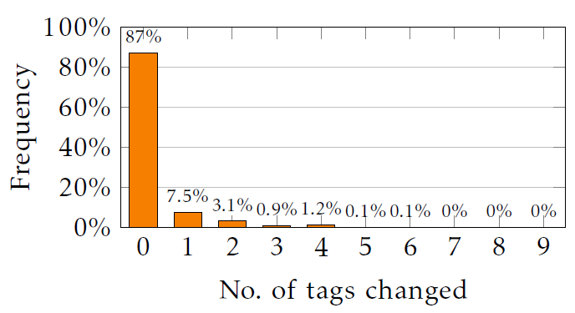
CRF Tagging

Slide 32
Incremental Parsing
How our factorization allows for efficient incremental parsing.

Slide 33
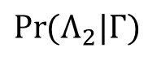
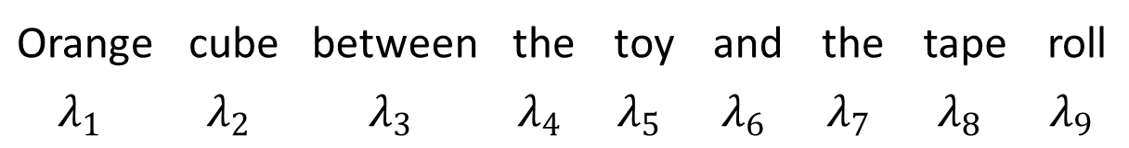

Tree Structure
$$Γ$$
$$\operatorname{Pr}{(Λ_{2}|Γ)}$$
Use the preposition model to generate a distribution using prepositions.
Use the unigram language model to convert each grounding to a distribution
$$\operatorname{Pr}{(Λ_{1}|Γ) }$$ |  | $$\operatorname{Pr}{(Λ_{2,1}|Γ)}$$ |  | $$\operatorname{Pr}{(Λ_{2,2}|Γ) }$$
Orange | cube | between | the | toy | and | the | tape | roll
$$λ_{1}$$ | $$λ_{2}$$ | $$λ_{3}$$ | $$λ_{4}$$ | $$λ_{5}$$ | $$λ_{6}$$ | $$λ_{7}$$ | $$λ_{8}$$ | $$λ_{9}$$

Slide 34
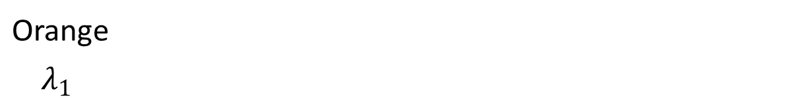
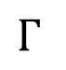
Incremental Parsing
$$Γ$$
From cache
Recomputed
this step
$$\operatorname{Pr}{(Λ_{1}|Γ) }$$
Orange
$$λ_{1}$$

Slide 35
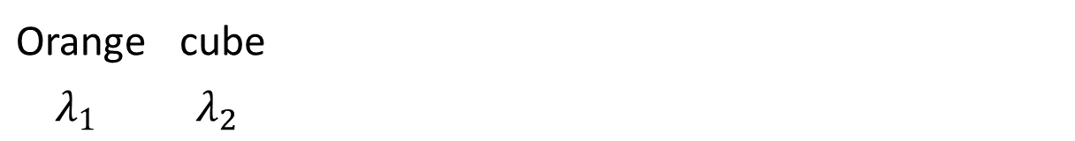
Incremental Parsing
$$Γ$$
From cache
Recomputed
this step
$$\operatorname{Pr}{(Λ_{1}|Γ) }$$
Orange | cube
$$λ_{1}$$ | $$λ_{2}$$

Slide 36
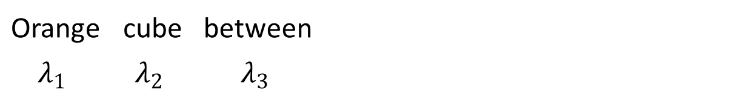
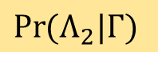
Incremental Parsing
$$Γ$$
From cache
Recomputed
this step
$$\operatorname{Pr}{(Λ_{2}|Γ)}$$
$$\operatorname{Pr}{(Λ_{1}|Γ) }$$
Orange | cube | between
$$λ_{1}$$ | $$λ_{2}$$ | $$λ_{3}$$

Slide 37
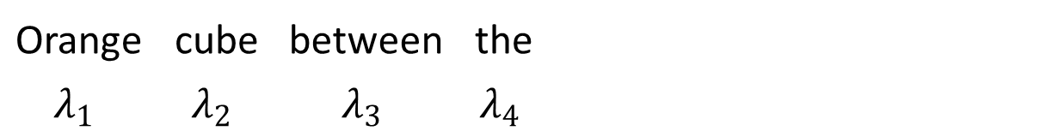
Incremental Parsing
$$Γ$$
From cache
Recomputed
this step
$$\operatorname{Pr}{(Λ_{2}|Γ)}$$
$$\operatorname{Pr}{(Λ_{1}|Γ) }$$ |  | $$\operatorname{Pr}{(Λ_{2,1}|Γ)}$$
Orange | cube | between | the
$$λ_{1}$$ | $$λ_{2}$$ | $$λ_{3}$$ | $$λ_{4}$$

Slide 38
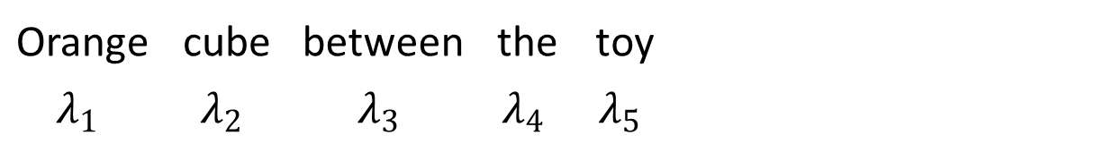
Incremental Parsing
$$Γ$$
From cache
Recomputed
this step
$$\operatorname{Pr}{(Λ_{2}|Γ)}$$
$$\operatorname{Pr}{(Λ_{1}|Γ) }$$ |  | $$\operatorname{Pr}{(Λ_{2,1}|Γ)}$$
Orange | cube | between | the | toy
$$λ_{1}$$ | $$λ_{2}$$ | $$λ_{3}$$ | $$λ_{4}$$ | $$λ_{5}$$

Slide 39
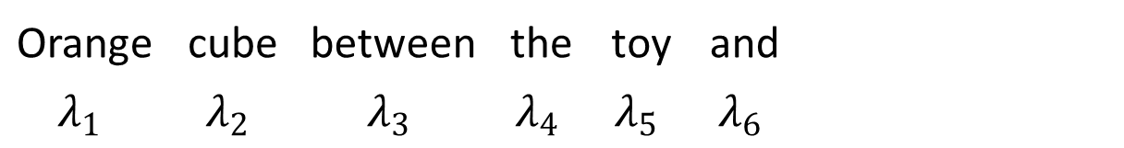
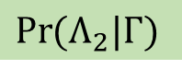
Incremental Parsing
$$Γ$$
From cache
Recomputed
this step
$$\operatorname{Pr}{(Λ_{2}|Γ)}$$
$$\operatorname{Pr}{(Λ_{1}|Γ) }$$ |  | $$\operatorname{Pr}{(Λ_{2,1}|Γ)}$$
Orange | cube | between | the | toy | and
$$λ_{1}$$ | $$λ_{2}$$ | $$λ_{3}$$ | $$λ_{4}$$ | $$λ_{5}$$ | $$λ_{6}$$

Slide 40
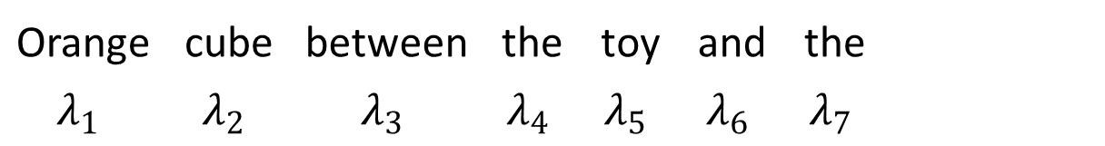
Incremental Parsing
$$Γ$$
From cache
Recomputed
this step
$$\operatorname{Pr}{(Λ_{2}|Γ)}$$
$$\operatorname{Pr}{(Λ_{1}|Γ) }$$ |  | $$\operatorname{Pr}{(Λ_{2,1}|Γ)}$$ |  | $$\operatorname{Pr}{(Λ_{2,2}|Γ) }$$
Orange | cube | between | the | toy | and | the
$$λ_{1}$$ | $$λ_{2}$$ | $$λ_{3}$$ | $$λ_{4}$$ | $$λ_{5}$$ | $$λ_{6}$$ | $$λ_{7}$$

Slide 41
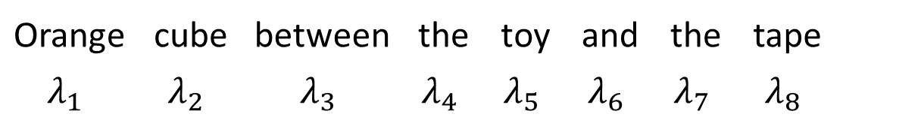
Incremental Parsing
$$Γ$$
From cache
Recomputed
this step
$$\operatorname{Pr}{(Λ_{2}|Γ)}$$
$$\operatorname{Pr}{(Λ_{1}|Γ) }$$ |  | $$\operatorname{Pr}{(Λ_{2,1}|Γ)}$$ |  | $$\operatorname{Pr}{(Λ_{2,2}|Γ) }$$
Orange | cube | between | the | toy | and | the | tape
$$λ_{1}$$ | $$λ_{2}$$ | $$λ_{3}$$ | $$λ_{4}$$ | $$λ_{5}$$ | $$λ_{6}$$ | $$λ_{7}$$ | $$λ_{8}$$

Slide 42
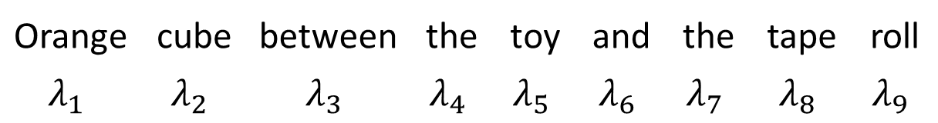
Incremental Parsing
$$Γ$$
From cache
Recomputed
this step
$$\operatorname{Pr}{(Λ_{2}|Γ)}$$
$$\operatorname{Pr}{(Λ_{1}|Γ) }$$ |  | $$\operatorname{Pr}{(Λ_{2,1}|Γ)}$$ |  | $$\operatorname{Pr}{(Λ_{2,2}|Γ) }$$
Orange | cube | between | the | toy | and | the | tape | roll
$$λ_{1}$$ | $$λ_{2}$$ | $$λ_{3}$$ | $$λ_{4}$$ | $$λ_{5}$$ | $$λ_{6}$$ | $$λ_{7}$$ | $$λ_{8}$$ | $$λ_{9}$$

Slide 43
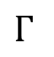
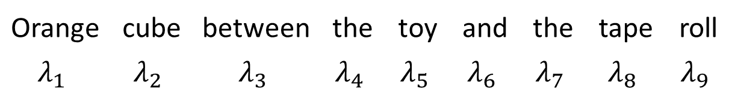
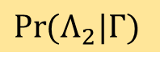
Incremental Parsing
$$Γ$$
From cache
Recomputed
this step
Maximum depth of 3, which limits the work done per step.
$$\operatorname{Pr}{(Λ_{2}|Γ)}$$
$$\operatorname{Pr}{(Λ_{1}|Γ) }$$ |  | $$\operatorname{Pr}{(Λ_{2,1}|Γ)}$$ |  | $$\operatorname{Pr}{(Λ_{2,2}|Γ) }$$
Orange | cube | between | the | toy | and | the | tape | roll
$$λ_{1}$$ | $$λ_{2}$$ | $$λ_{3}$$ | $$λ_{4}$$ | $$λ_{5}$$ | $$λ_{6}$$ | $$λ_{7}$$ | $$λ_{8}$$ | $$λ_{9}$$

Slide 44
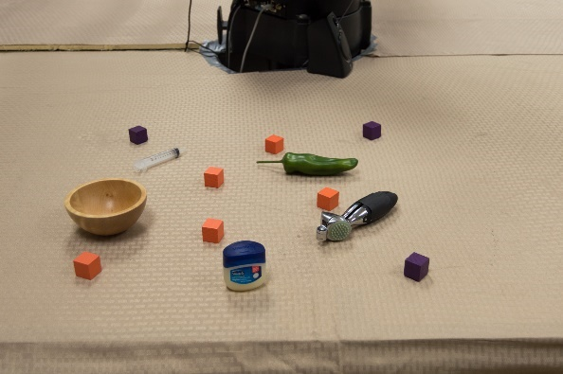
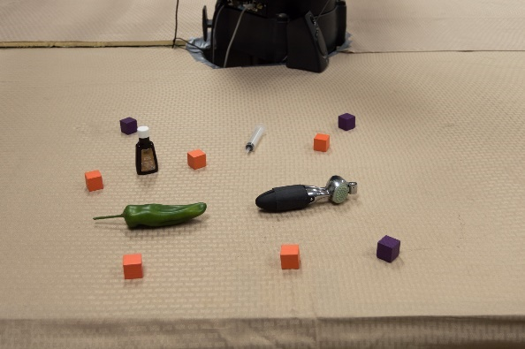
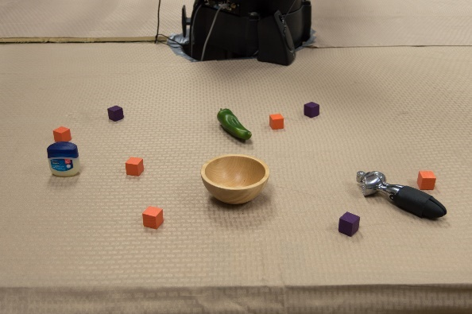
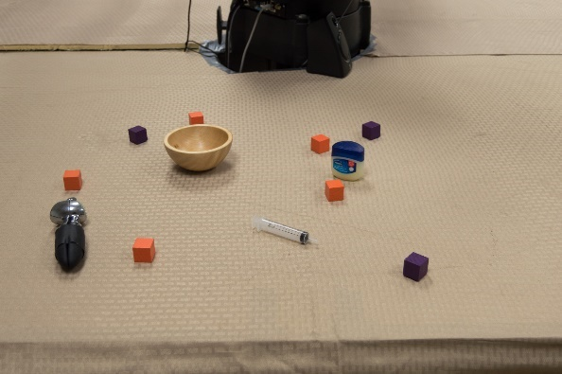
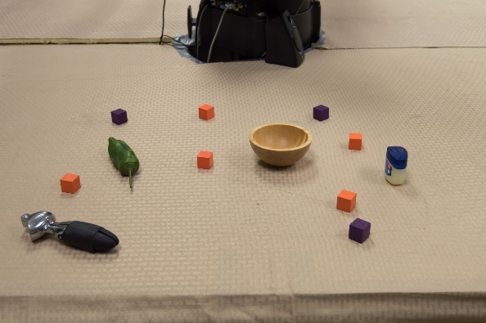














Turk Tasks

Slide 45


Slide 46
Baseline

Slide 47
Results

Slide 48


Slide 49
Time taken to process next word

Slide 50


Slide 51

Future Work
Implement it on Baxter
Pick-and-place task
Perform a user-study to see if it improves interaction (compared to batch-mode.)
Social feedback
Integrate it with Emily Wu’s social feedback framework.

Slide 52
Contributions
Referring Expression parsing
Model for incremental parsing
Implementation
Fast enough to keep up with speech
Real-world data
Used to characterized accuracy and performance

Slide 53

Failure Analysis: Incorrect & Imprecise Data
We test the correctness of our model on subsets of the test set.
r is the number of human raters that have correctly identified the target.

